Slide 1

Analysis and predictive modeling of hotel cancellation and price trends
Soyoung An
Jun 2021

Slide 2
Overview
Often, hotel cancellation can lead to the business loss. Having ability to accurately predict future customers’ cancellation rates is important. Predicting a hotel price rate is essential to evaluate demand for accommodation and pricing the room rates accordingly.
Predicting the actual demand and price can help to reduce the unexpected profit loss.
Goals
Identify the key factors that influence cancellation rate and price
Identify whether the average daily rates (ADR) between two groups (cancelled/not cancelled) are same
Develop a predictive models to estimate cancellation and price
Data
Hotel booking observations from a resort hotel and city hotel where the resort hotel located in Algarve and the city hotel in Lisbon.
40,060 rows 32 features
Notes:
The purpose of this project is for hotels to identify and analyze the customer’s behavior and reduce cancellation and set good price points which can increase profit. Go over goals and data
Some of examples of features includes things like leading time until the booking confirmed, room type, meal type, date, repeated customer, agent and more features associated with hotel booking transaction.

Slide 3
Description of hotel bookings
No | Feature Name | Feature Description | Data Type
1 | hotel | Resort Hotel (H1) or City Hotel (H2) | Object
2 | is_canceled | Value indicating if the booking was cancelled (1) or not (0) | Integer
3 | lead_time | Number of days between the booking date to the arrival date | Integer
4 | arrival_date_year | Year of arrival | Integer
5 | arrival_date_month | Month of arrival | Object
6 | arrival_date_week_number | Week number according to year of arrival | Integer
7 | arrival_date_day_of_month | Day of arrival | Integer
8 | stays_in_weekend_nights | Number of weekend nights booked (Saturday and Sunday) | Integer
9 | stays_in_week_nights | Number of weeknights booked (Monday to Friday) | Integer
10 | adults | Number of adults | Integer
11 | children | Number of children | Integer
12 | babies | Number of babies | Integer
13 | meal | Type of meal booked | Object
14 | country | Country of customer’s origin | Object
15 | market_segment | Market segment designation | Object
16 | distribution_channel | Booking distribution channel (how the booking was made) | Object
17 | is_repeated_guest | Value indication if the booking was from a repeated guest (1) or not (0) | Integer
18 | previous_cancellations | Number of previous cancellations prior to current booking | Integer
19 | previous_bookings_not_canceled | Number of previous booking not cancelled prior to current booking | Integer
20 | reserved_room_type | Reserved room type code | Object
21 | assigned_room_type | Code for the type of room assigned to the booking | Object
22 | booking_changes | Number of changes made to the booking since entering the hotel management system | Integer
23 | deposit_type | Type of deposit made for the reservation (No Deposit, Refundable, Non refund) | Object
24 | agent | ID of the travel agency that made the booking | Float
25 | company | ID of the company/ organization that made the booking or is responsible for payment | Float
26 | days_in_waiting_list | Number of days booking was in the waiting list until it was confirmed | Integer
27 | customer_type | Type of booking | Object
28 | adr | Average Daily Rate (the sum of transactions divided by the number of nights stayed) | Float
29 | required_car_parking_spaces | Number of car parking spaces requested | Integer
30 | total_of_special_requests | Number of special requests made by the customer | Integer
31 | reservation_status | Last reservation status (Cancelled, Check-Out, No-Show) | Object
32 | reservation_status_date | Date at which the last status was set | Object

Slide 4

Data Wrangling
Processed date types data and stored them into year, month, day separately
Dropped any columns with more than 50% missing values
Implicated missing values with reasonable data
Dropped suspicious data with no additional information available
After Data Wrangling Process,
Final dataset left with
116,951 rows and 35 columns
(Original dataset: 119,390 rows and 32 columns)

Slide 5
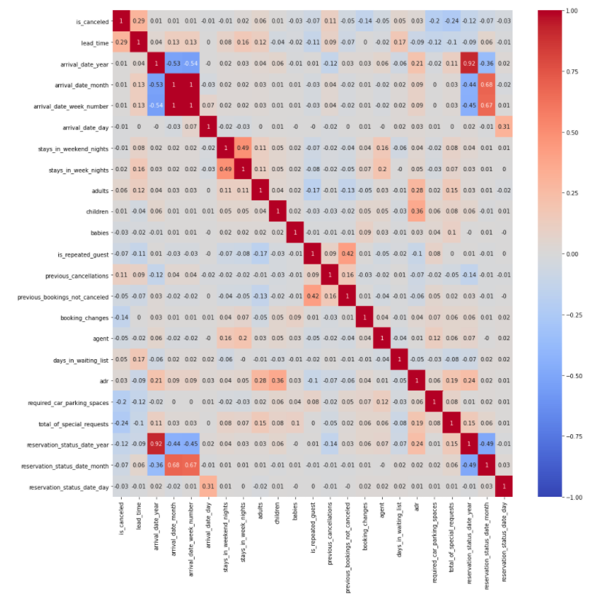
Important factors affecting cancellation and price
Cancellation
Lead_time
Previous_cancellation
Days_in_waiting_list
adr
Average Daily Rate (ADR)
Children
Adults
Reservation_status_date_year
Arrival_date_year
Total_of_special_requests
Heatmap of correlation coefficients between variables

Slide 6
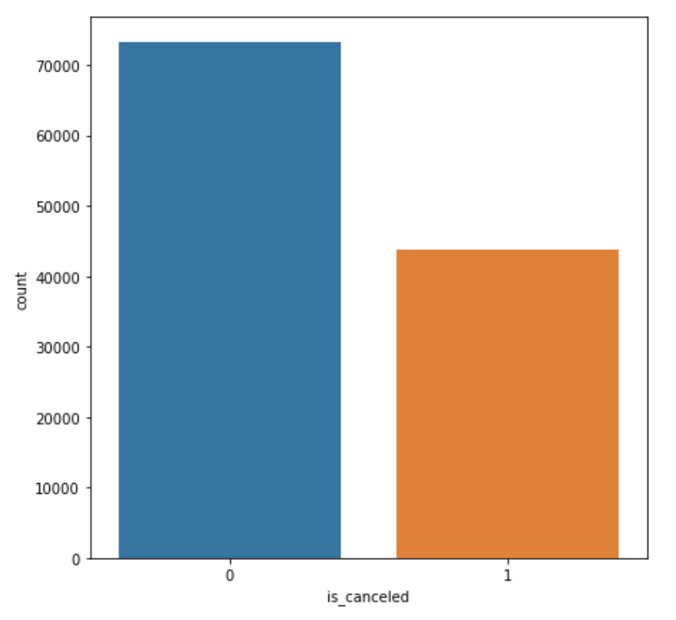
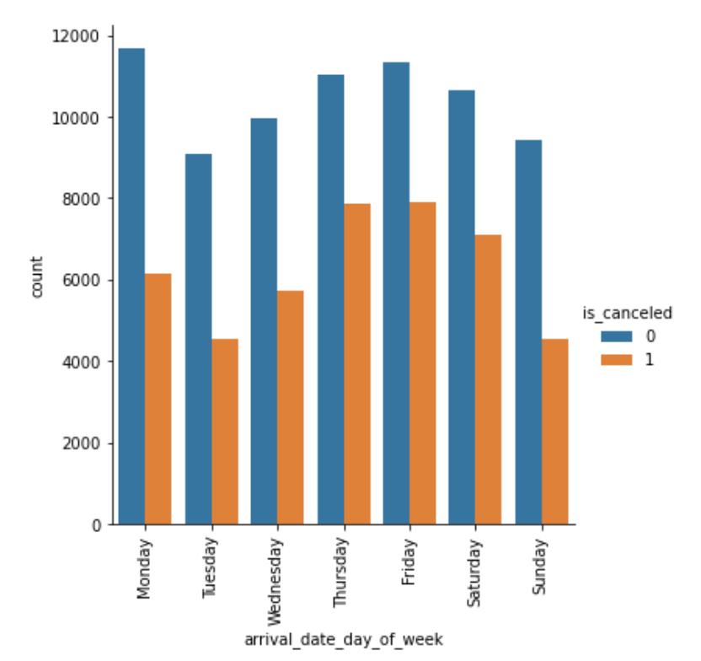
Canceled vs Non-canceled
Not Cancelled Reservations: 73,140
Cancelled reservations: 43,811
Count plot of different cancellation types
Count plot by day of week and cancellation type

Slide 7
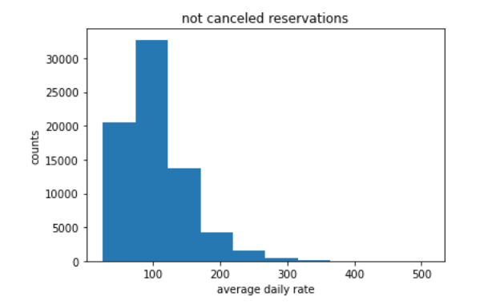
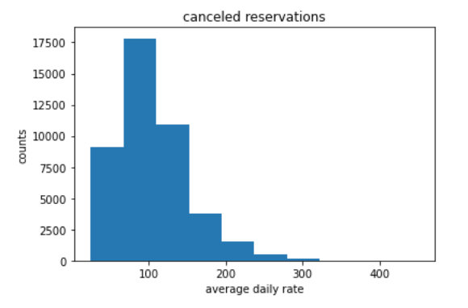
price rates are same in two cancellation type groups?
Null hypothesis: The average daily rate price (ADR) booked by who has cancelled the reservation has the same rate as people who is not cancelled.
Alternative hypothesis: The average daily rate price (ADR) booked by who has cancelled the reservation does NOT have the same rate as people who is not cancelled.
Method
Bootstrapping
t-test
Results : p-value < 0.05
Reject the null hypothesis and accept alternative hypothesis
Average daily rate (ADR) between
two groups are DIFFERENT!

Slide 8
Modeling Approach
Logistic Regression (Cancellation) / Linear Regression (Price)
KNN
SVM
Decision Tree
Gradient Boosting
Random Forest

Slide 9
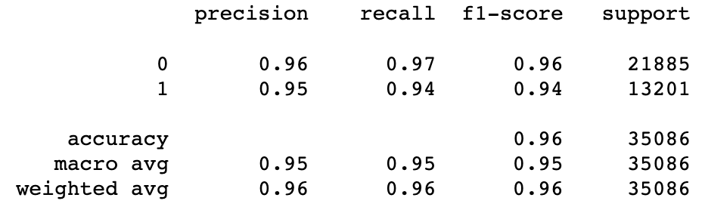
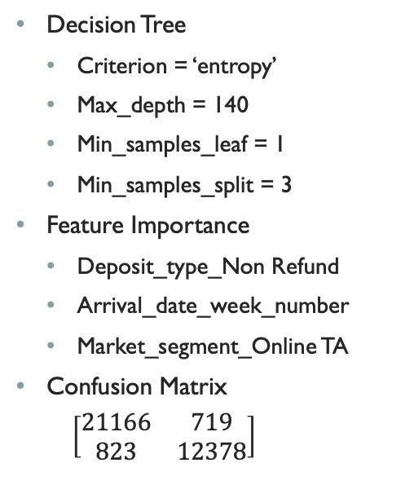
Best Hotel Cancellation Model
Decision Tree
Criterion = ‘entropy’
Max_depth = 140
Min_samples_leaf = 1
Min_samples_split = 3
Feature Importance
Deposit_type_Non Refund
Arrival_date_week_number
Market_segment_Online TA
Confusion Matrix
$\left[\begin{matrix}21166 & 719 \\ 823 & 12378\end{matrix}\right]$
Classification Report for Decision Tree with tuned parameters

Slide 10
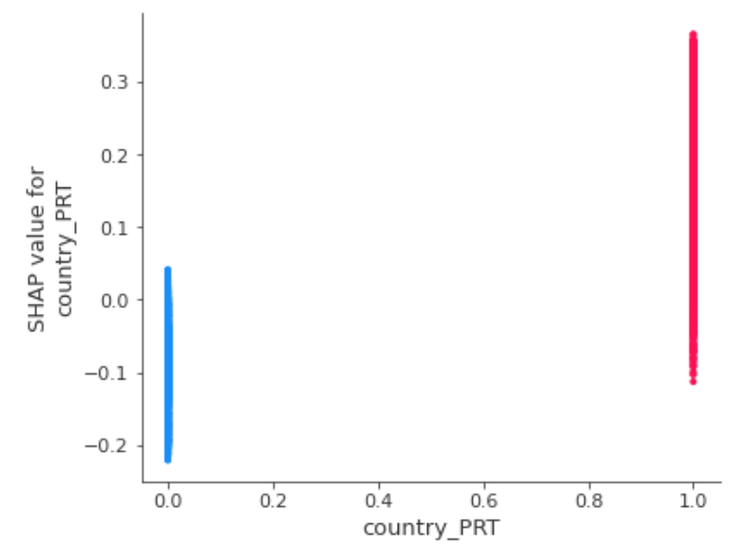
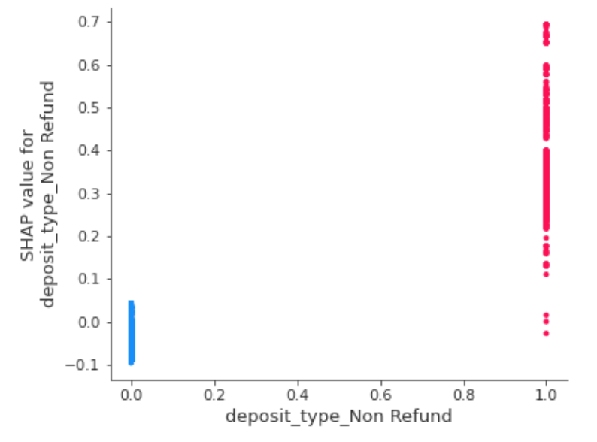
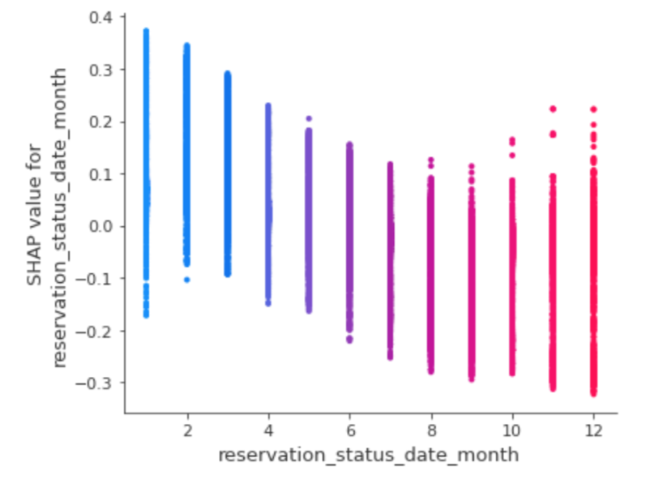
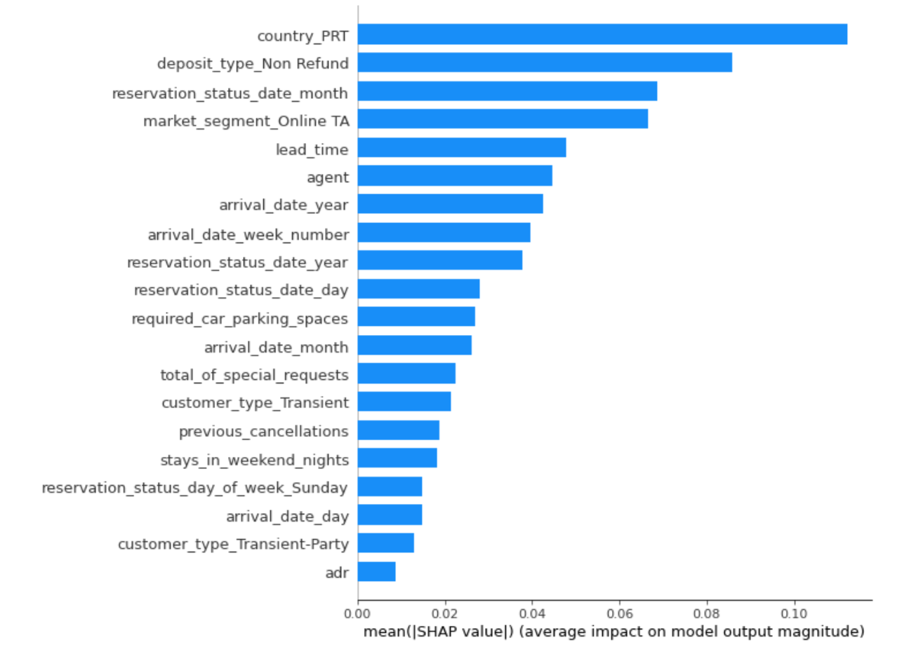
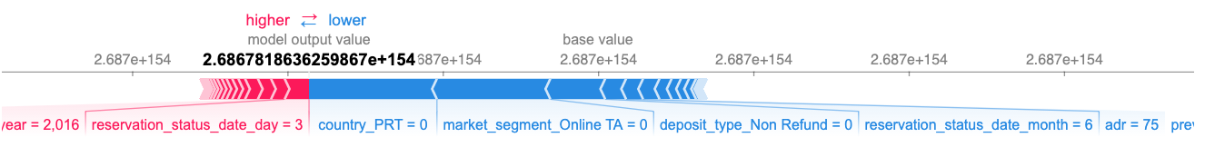
Comparative studies on cancellation predictive models
Top 3 Features affecting cancellation (1):
Country_PRT (Portugal)
Deposit_type_Non Refund
Reservation_status_date_month
Cancelled reservation
Not cancelled reservation

Slide 11
Best Hotel Price Model
Random Forest
n_estimator = 1000
max_depth = 50
max_features = ‘auto’
Errors
R squared: 0.926
Mean Squared Error: 12.675
Mean Absolute Error: 6.5474
Top 5 Important features
Arrival_date_month
Reserved_room_type_A
Arrival_date_week_number
Children
Agent

Slide 12
Conclusions
Provided hotels the analysis to reduce cancellation and set reasonable price points which helps to reduce unexpected profit loss
Developed classification and regression models for hotel using various machine learning algorithms with above 90% average accuracy (classification) and 0.92 R² error (regression) in model performance
Performed comparative studies to analyze how feature importance impacts the results of the price and cancellation models for individual transactions for customers

